Slide 1
DLR Project
Technical Lecture: Blockchain & EEE*-Components
12.02.2025
Blockchain demonstration (TRL2/3**) for
Space Commercial Off-The-Shelf (COTS) procurement
Christoph Langewisch, Focus on Technical Demonstrator
* Electrical, Electronic, and Electromechanical
**Experimental proof of concept

Slide 2
Approach: Process digitalization for the qualification and use of EEE Components from non-space industries (e.g. automotive industry) for Space Applications
Key Challenges
Lack of transparency (Specifications & Properties)
Unclear origin of COTS components
Lack of lot traceability and serialization
Frequent and unannounced product changes
Each parts are tested by itself
SCM Procurement – classified EEE components
(Space Industry)
Filling the gap
Parts Approval Document (PAD)
Parts Control Board (PCB)
Seamless traceability at the component level
Official changes by manufacturer
Proof that a non-space-qualified COTS component is permitted for use in a space mission
Supply Chain Management (SCM)
- COTS ( Automotive Industry)
Parts are tested on a production line level
Notes:
The important difference from Automotive to space is that parts are tested on a production line level and not each part by itself.
SCM for Space – Procurement
PPAP (Production Part Approval Process) in the Automotive Supply Chain
Parts Control Board:
PAD - Parts Approval Document
Declared Component List
JD - Justification Document (COTS)
PCN - Parts Change Notice
Different environmental conditions

Slide 3
Main Aspects: Transferring the real world into the digital one to use EEE Components from non-space industries for Space Applications (SA)
Parts Approval Document (PAD)
Parts Control Board (PCB)
High documentation requirements by
Ensures that only highly reliable components are used for Space Applications
Multidisciplinary team (cross-process) of experts involved for planning, execution and monitoring of Parts Control Board (PCB):
Parts Approval Document (PAD)
EEE-Parts of each single element required
Proof of additional tests per part (e.g. radiation, temperature, vibration, lifespan)
Control of long-term availability
Engineers: Assess technical specifications
Quality Assurance Engineers: checks reliability
Radiation Hardness Assurance (RHA) Experts
Materials & Manufacturing Specialists
System Engineers & Mission Managers
Supply Chain & Obsolescence Managers
Space Agencies & Prime Contractors
Additional:
Declared Component List: Quality assurance, traceability and risk analysis
Justification Document: Proof that a non-space-qualified COTS component is permitted for use in a space mission
Parts Change Notice (PCN - official changes by manufacturer)

Slide 4
Technical Demonstration: How Blockchain can support the use of EEE components from non-space industries for Space Applications (SA)
Selected focus for technical demonstration (real world –> digitalization, with impact by Blockchain)
Requirement / Use-Case | Impact by Blockchain | Comment
Multidisciplinary Team Account | Supports interoperability, digital twins of a trusted user accounts sign transactions of cross-industry processes | Trusted information flow, enhance transparency, security, and efficiency in the decision-making process
EEE-Parts as digital twin | Digital twin of single EEE-parts is basic requirement to transform from real to digital world, real-time data access, ensuring long-term data integrity, security and traceability | Trusted digital representative of single EEE-parts are needed to simulate, validate, and monitor these parts about information like status, justification, change notice, …
Digital Justification Document for EEE-Parts | Ensures secure, tamper-proof records of qualification decisions, ensures regulatory compliance, automated verification, speeds up decision-making, long-term storage | enhances security, traceability, automation, and compliance verification for EEE components in high-reliability environments
Declared Component List (DCL) as a digital registry | Ensures full traceability, prevents unauthorized modifications, increases traceability, lowering costs, Improves supply chain transparency, procurement efficiency | Integrated with space agencies, certifiers and manufacturers ensures a more reliable, transparent, and secure component management process
Parts Change Notice (PCN) | Prevents unauthorized component modifications, tamper-proof, verifiable record of modification, automate compliance by smart contracts, real-time collaboration, long-term data retention | Detection of modifications, required for long-term planning, prevent unqualified components, support compliance
Proof of additional tests
Demonstrator Technology Readiness Level 2 / 3: Experimental proof of concept

Slide 5

Technical Demonstration: Parts Control Board (PCB) and involved multidisciplinary team members (cross-process) (1/2)
Demonstrator: Multi-User support
Multidisciplinary team members of the Parts Control Board (PCB) e.g.
Engineers: Assess technical specifications
Quality Assurance Engineers: checks reliability
Radiation Hardness Assurance (RHA) Experts
Materials & Manufacturing Specialists
System Engineers & Mission Managers
Supply Chain & Obsolescence Managers
Space Agencies & Prime Contractors
Why Blockchain?
Supports interoperability (across systems), digital twins of a trusted user accounts (by digital wallets) sign transactions (tamper-proofed) of cross-industry processes
https://base-platform.lakoma.com
Demonstrator Technology Readiness Level 2 / 3: Experimental proof of concept

Slide 6
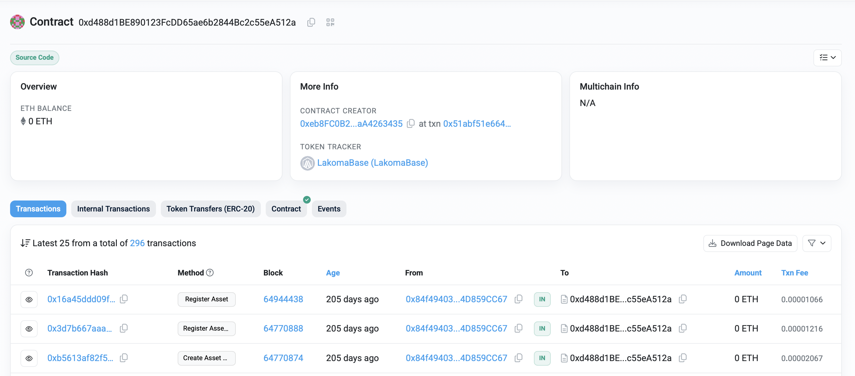
Technical Demonstration: Parts Control Board (PCB) and involved multidisciplinary team members (cross-process) (2/2)
Demonstrator: Smart-Contract to manage information exchange in decentralized, automated and tamper-proofed way
Parts Control Board (PCB) enabled by Smart-Contract, supported features:
Multidisciplinary teams: register, execute transactions
COTS vs. classified EEE components: Register, proof, verifiy, change
Why Blockchain?
Supports full automated rules by Smart-Contracts for tamper-proofed information exchange for multidisciplinary approaches
https://base-platform.lakoma.com
Demonstrator Technology Readiness Level 2 / 3: Experimental proof of concept

Slide 7
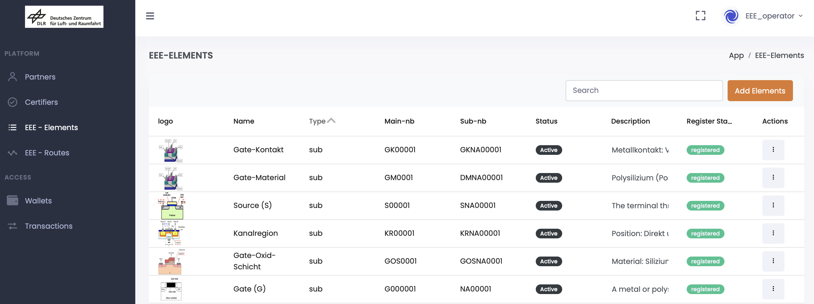
Technical Demonstration: EEE-Parts as digital twins
Demonstrator: Digital representative of EEE-parts
EEE-Parts as digital twins:
Trusted digital representative of single EEE-parts are needed to simulate, validate, and monitor these parts
Represents information like status, justification, change notice
Why Blockchain?
Supports full automated rules by Smart-Contracts of tamper-proofed information exchange for multidisciplinary approaches
https://base-platform.lakoma.com
Demonstrator Technology Readiness Level 2 / 3: Experimental proof of concept

Slide 8
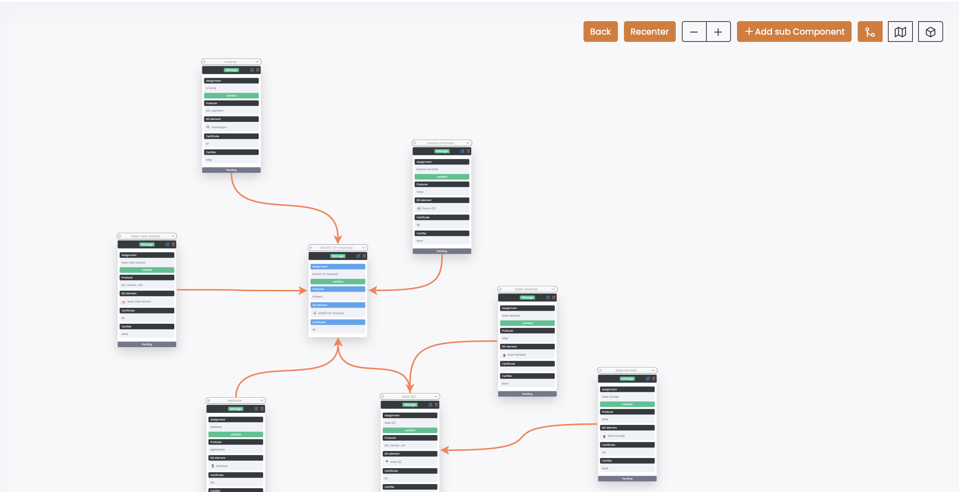
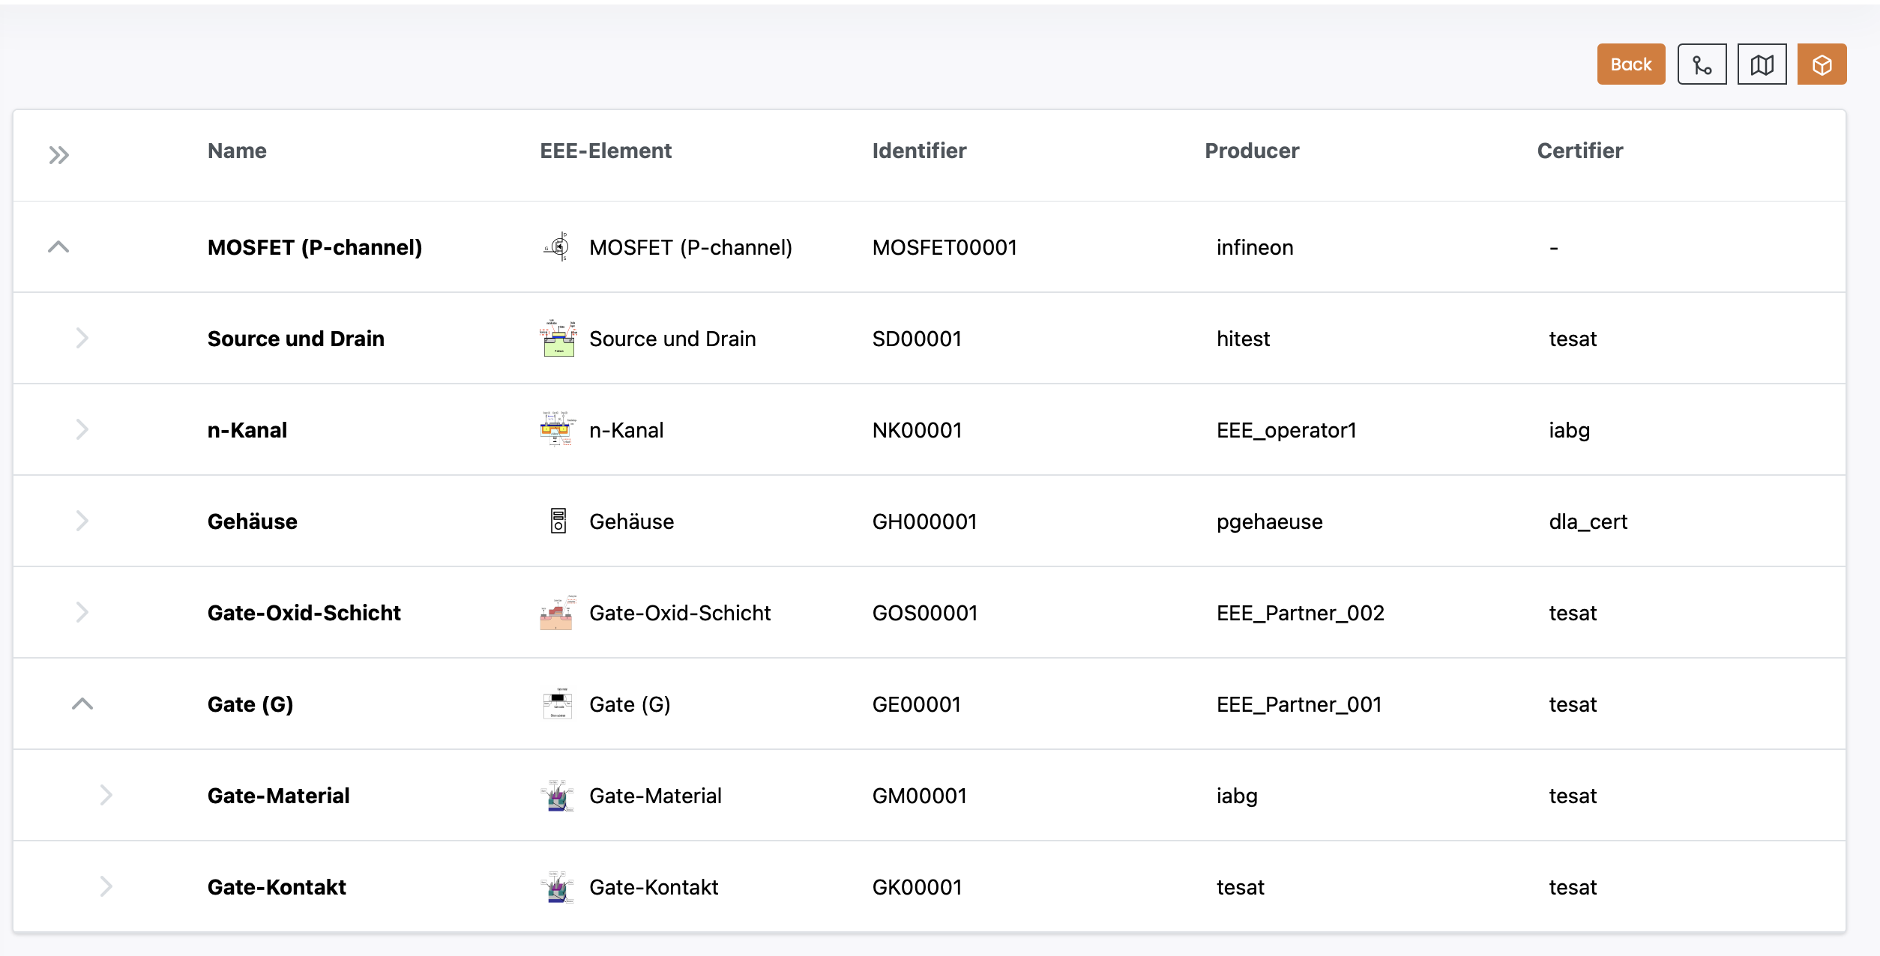
Technical Demonstration: Declared Component List (DCL)
Demonstrator: Digital representative of declared component list
Declared Component List for EEE-Parts:
Integrated with space agencies, certifiers and manufacturers ensures a more reliable, transparent, and secure component management process
Why Blockchain?
Ensures full traceability, prevents unauthorized modifications, increases traceability, lowering costs, Improves supply chain transparency, procurement efficiency
https://base-platform.lakoma.com
Demonstrator Technology Readiness Level 2 / 3: Experimental proof of concept

Slide 9
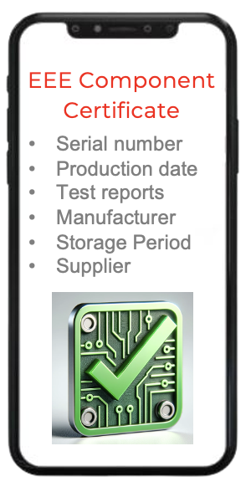


Technical Demonstration (Outlook): Digital Justification Proof for EEE-Parts
Demonstrator: Digital representative of justification document of a EEE component
Digital Justification Document for EEE-Parts:
represents information like status, justification, change notice
compliance verification for EEE components
enhances security
traceability for high-reliability environments
authorized
un-authorized
Why Blockchain?
Ensures secure, tamper-proof records of qualification decisions, ensures regulatory compliance, automated verification, speeds up decision-making, long-term storage
Demonstrator Technology Readiness Level 2 / 3: Experimental proof of concept

Slide 10
Technical Demonstration (Outlook): Parts Change Notice (PCN)
Demonstrator: Digital representative of declared component list
Declared Component List for EEE-Parts:
Detection of modifications
Required for long-term planning
Prevent unqualified components
Support compliance
Date | Modification | Classification
25.12.2024 | higher temperature support
13.01.2025 | Changed durability
02.02.2025 | Color change
Why Blockchain?
tamper-proof, verifiable record of modification, automate compliance by smart contracts, real-time collaboration, long-term data retention
https://base-platform.lakoma.com
Demonstrator Technology Readiness Level 2 / 3: Experimental proof of concept

Slide 11
Approach: Process digitalization for the qualification and use of EEE Components from non-space industries (e.g. automotive industry) for Space Applications
Each parts are tested by itself
Increased qualification & testing requirements
Different environmental conditions
Long-term reliability & durability
Radiation hardness & space radiation
SCM Procurement – classified EEE components
(Space Industry)
Filling the gap
Parts Approval Document (PAD)
Parts Control Board (PCB)
Seamless traceability at the component level
Official changes by manufacturer
Proof that a non-space-qualified COTS component is permitted for use in a space mission
Supply Chain Management (SCM)
- COTS ( Automotive Industry)
Parts are tested on a production line level
Notes:
Increase specifications, properties and reliability
The important difference from Automotive to space is that parts are tested on a production line level and not each part by itself.
SCM for Space – Procurement
PPAP (Production Part Approval Process) in the Automotive Supply Chain
Parts Control Board:
PAD - Parts Approval Document
Declared Component List
JD - Justification Document (COTS)
PCN - Parts Change Notice
Different environmental conditions

